Slide 1
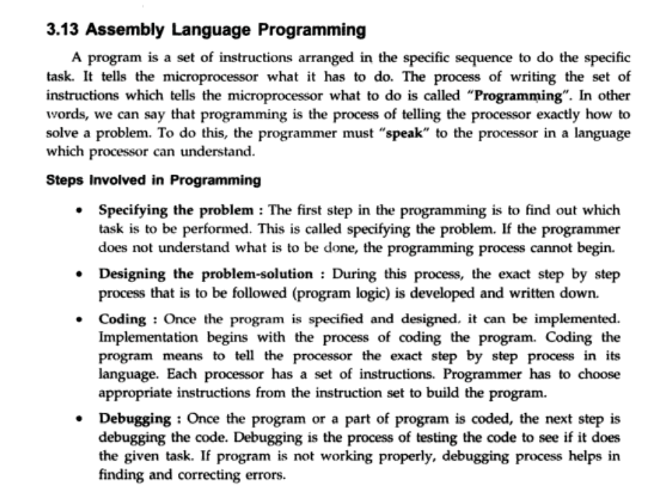

Slide 2
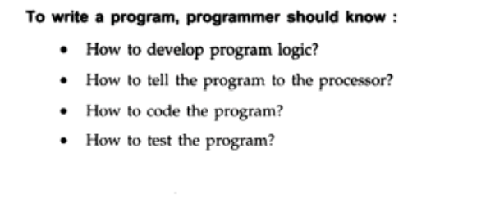

Slide 3
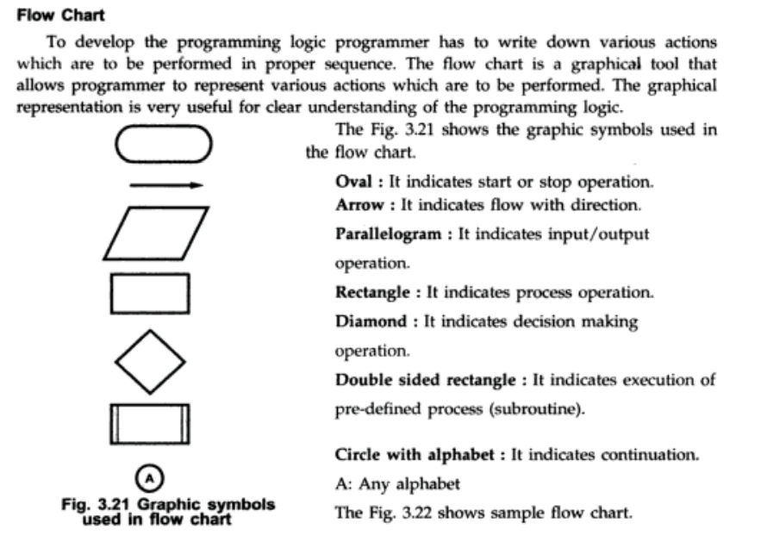

Slide 4
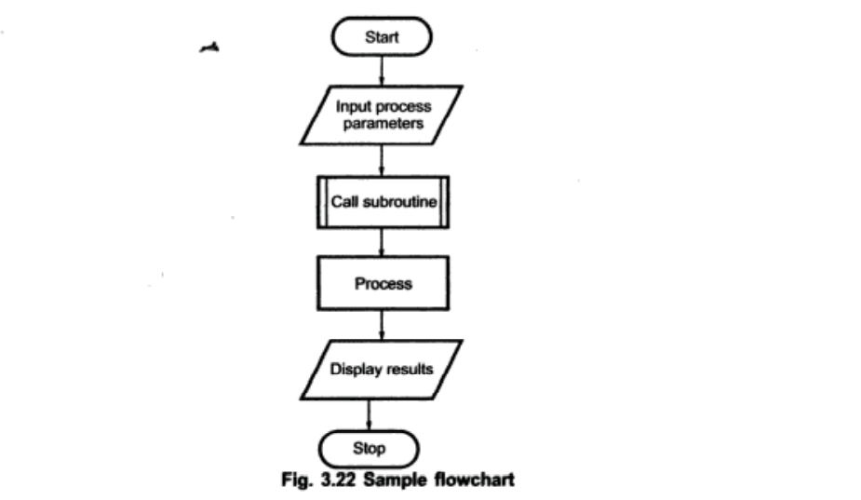

Slide 5
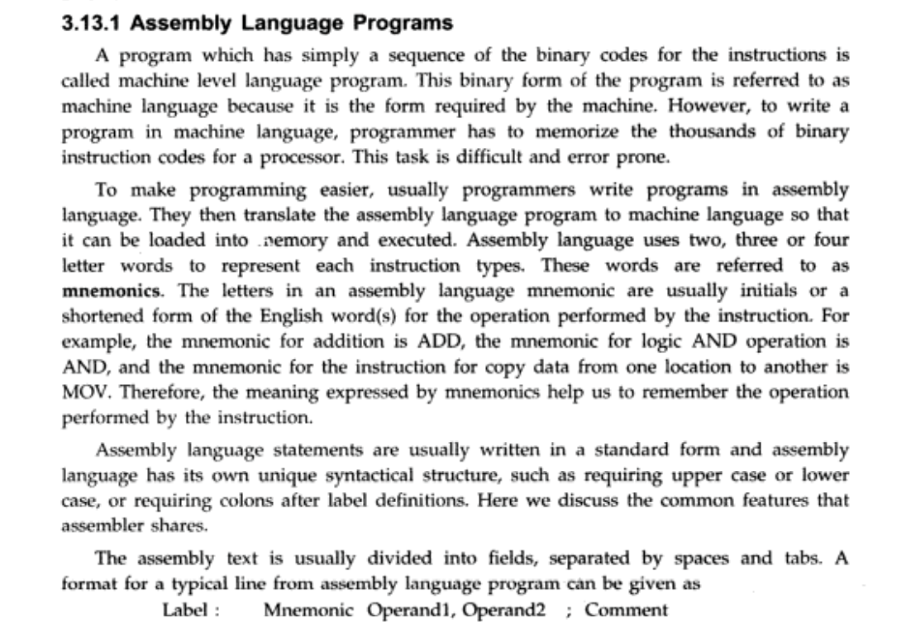

Slide 6
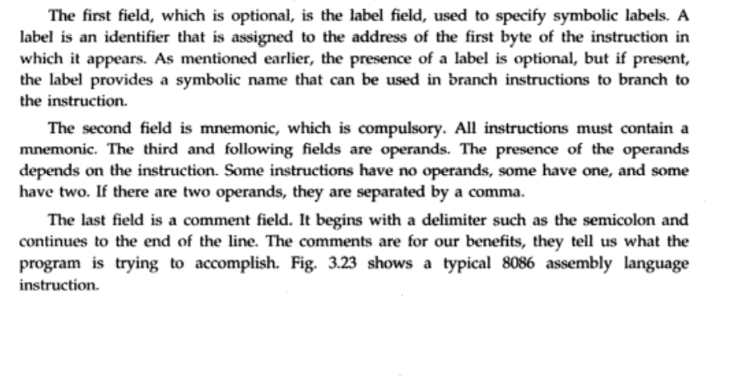

Slide 7
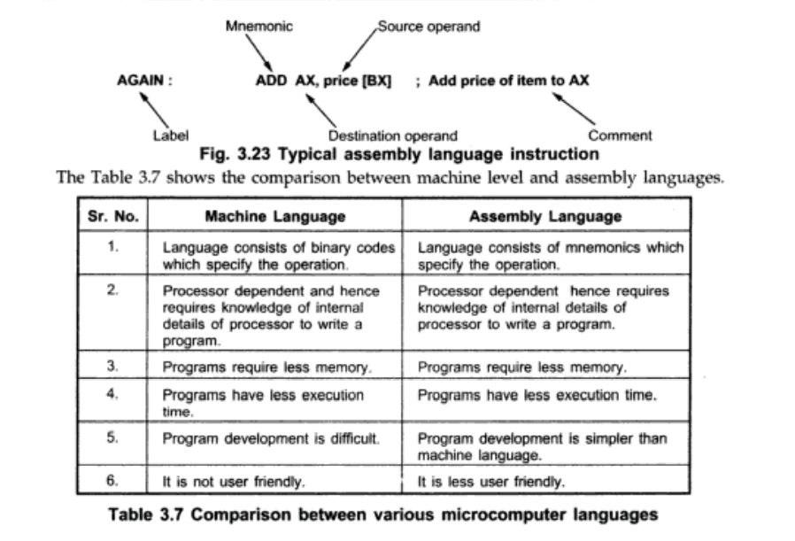

Slide 8
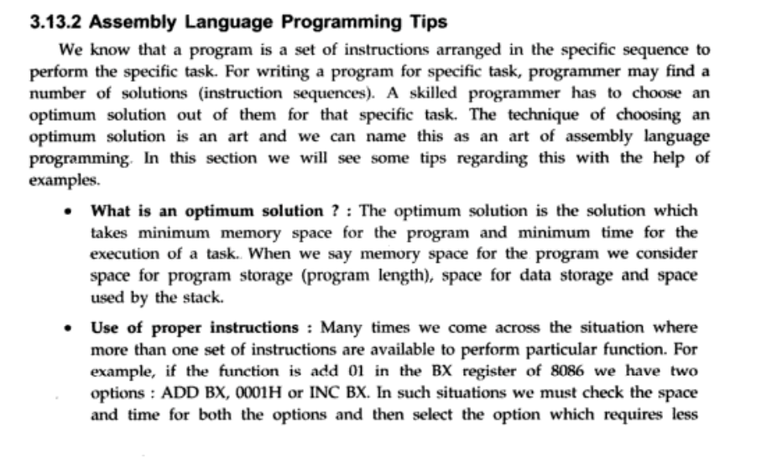

Slide 9
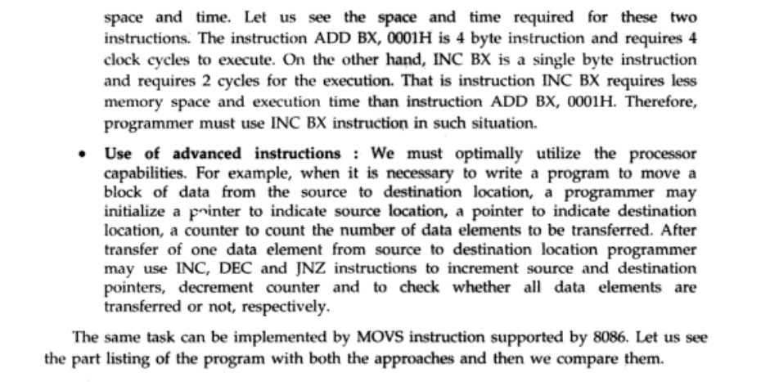

Slide 10
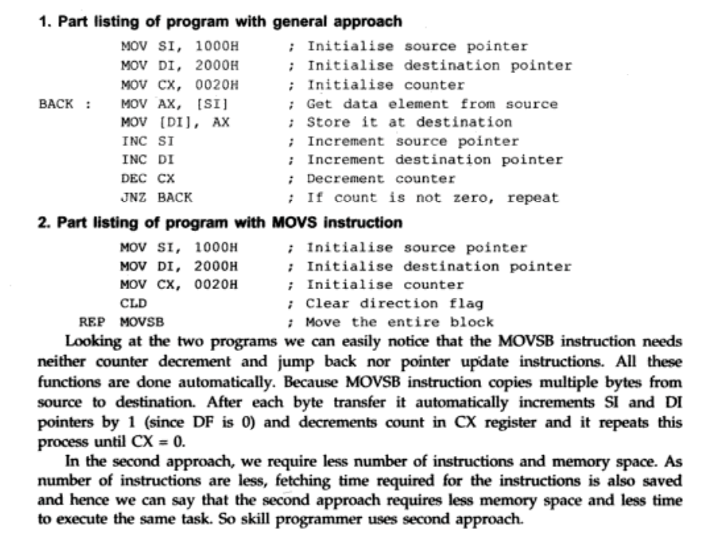

Slide 11
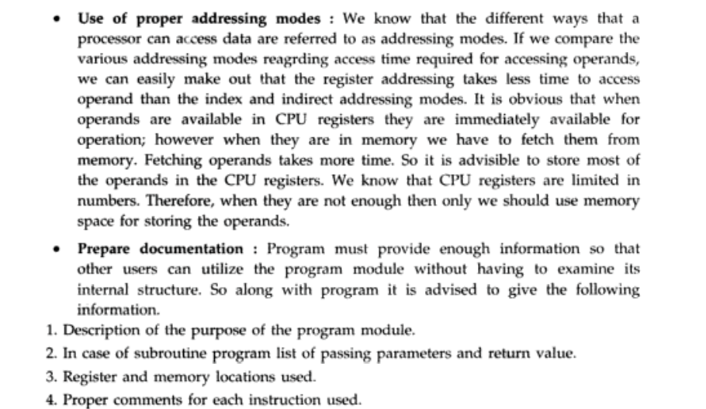

Slide 12
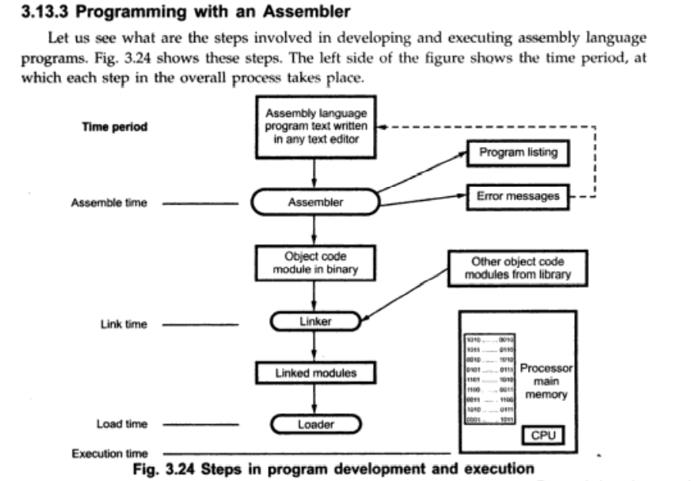

Slide 13
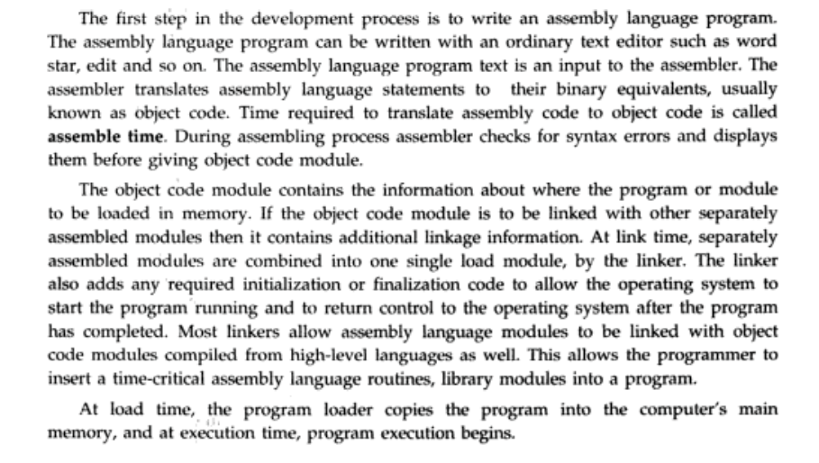

Slide 14
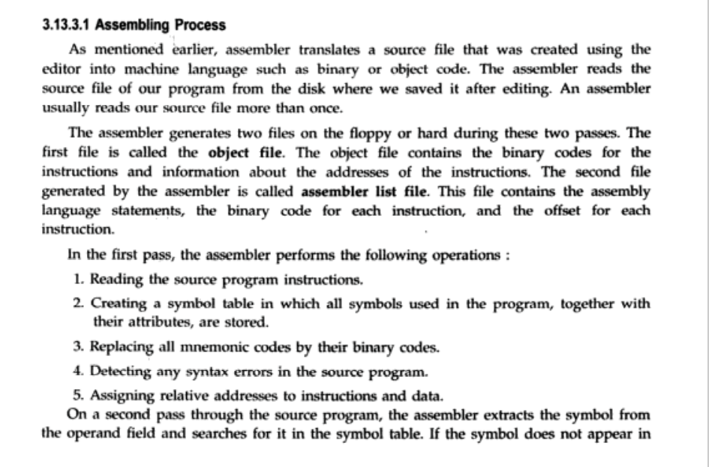

Slide 15
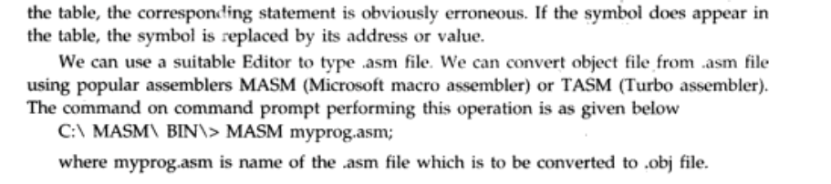
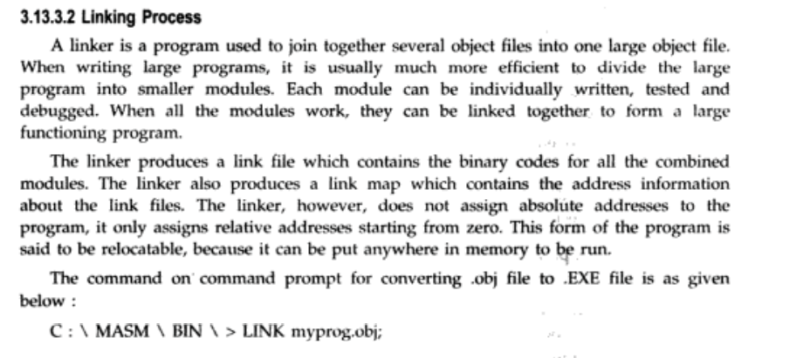

Slide 16
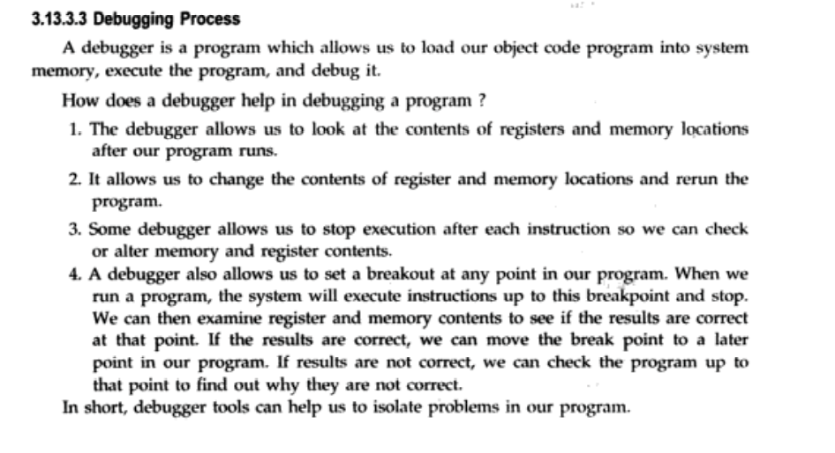

Slide 17
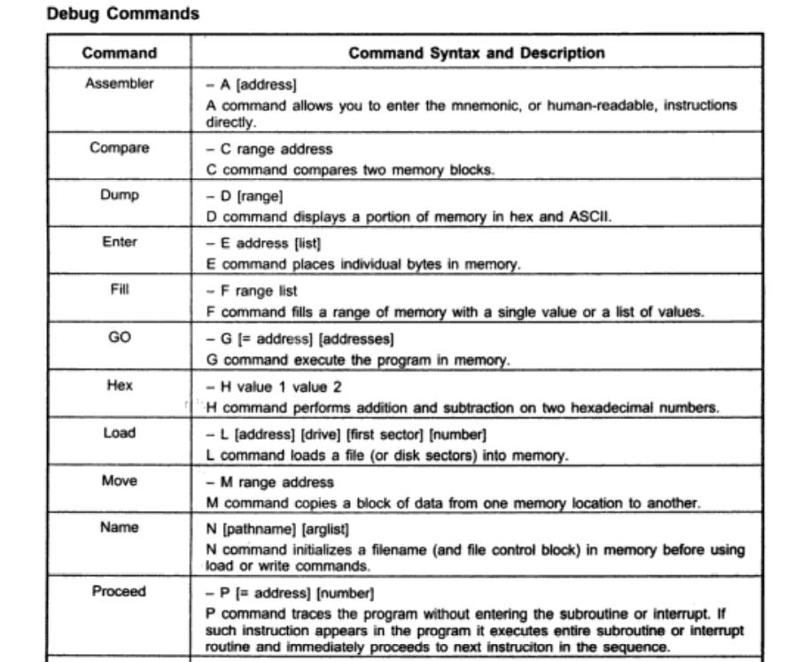

Slide 18
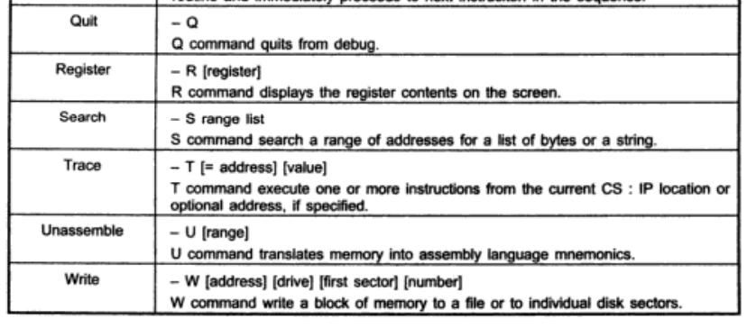

Slide 19
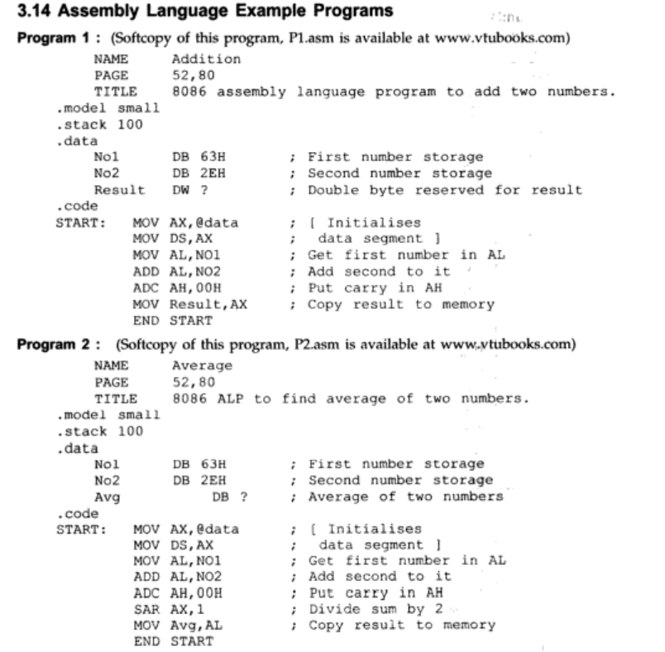

Slide 20
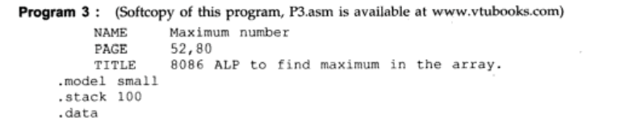
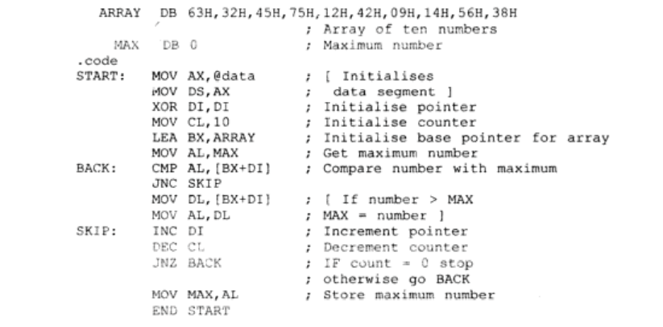

Slide 21
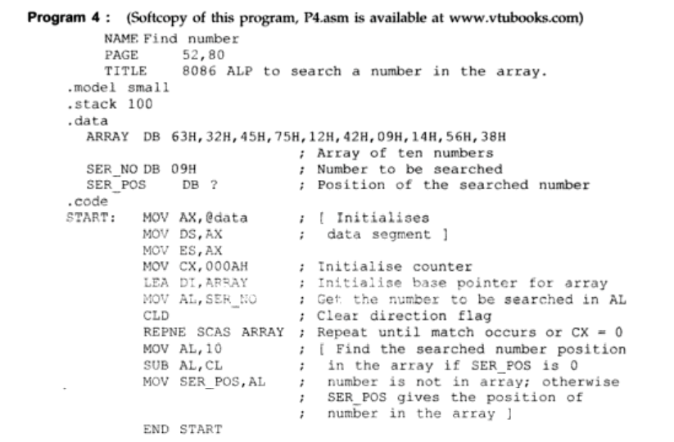

Slide 22

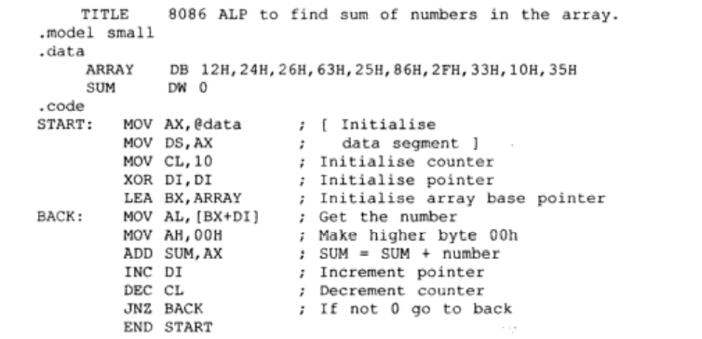

Slide 23
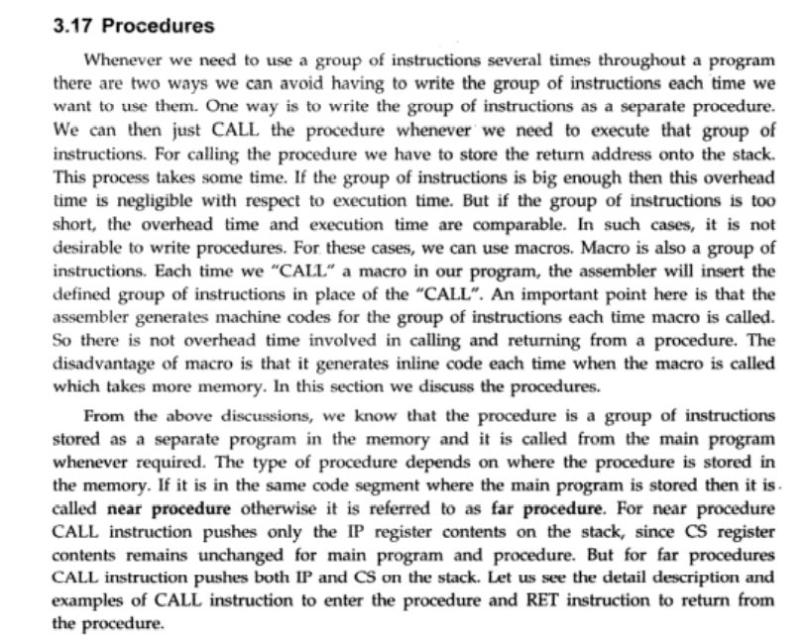

Slide 24
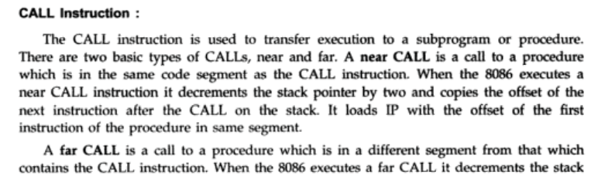
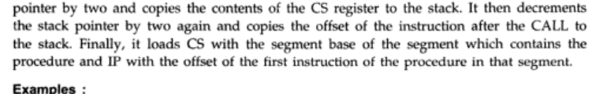

Slide 25
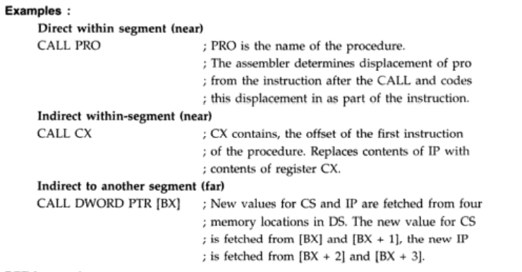

Slide 26
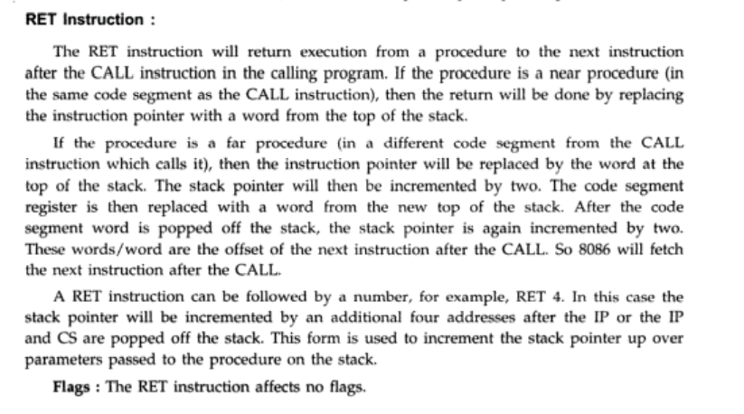

Slide 27
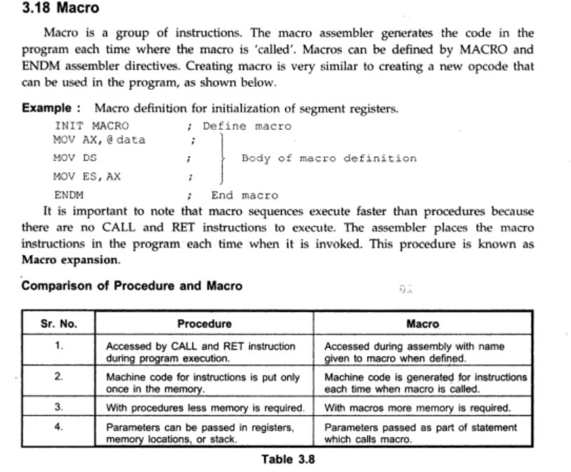

Slide 28
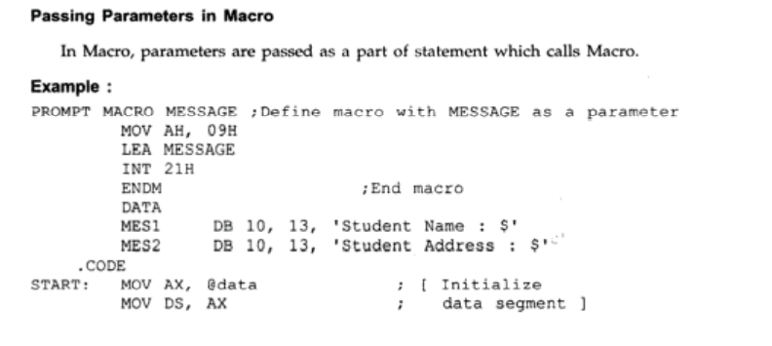
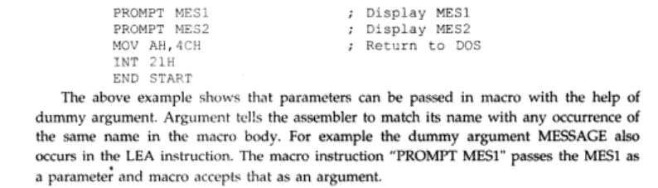

Slide 29
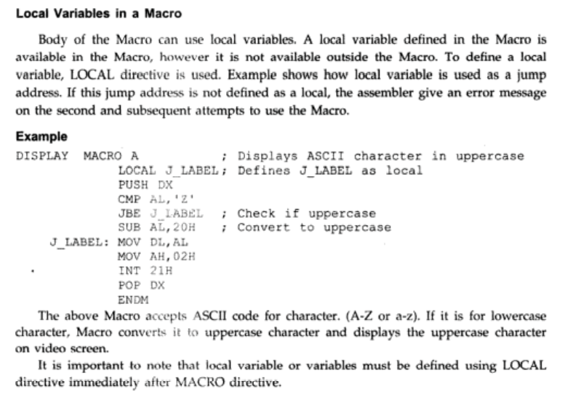

Slide 30
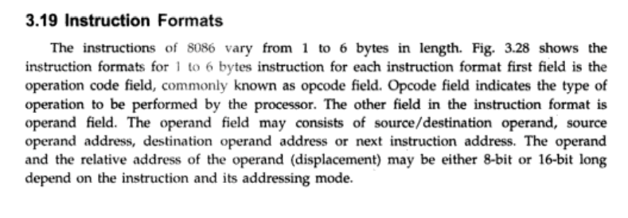

Slide 31
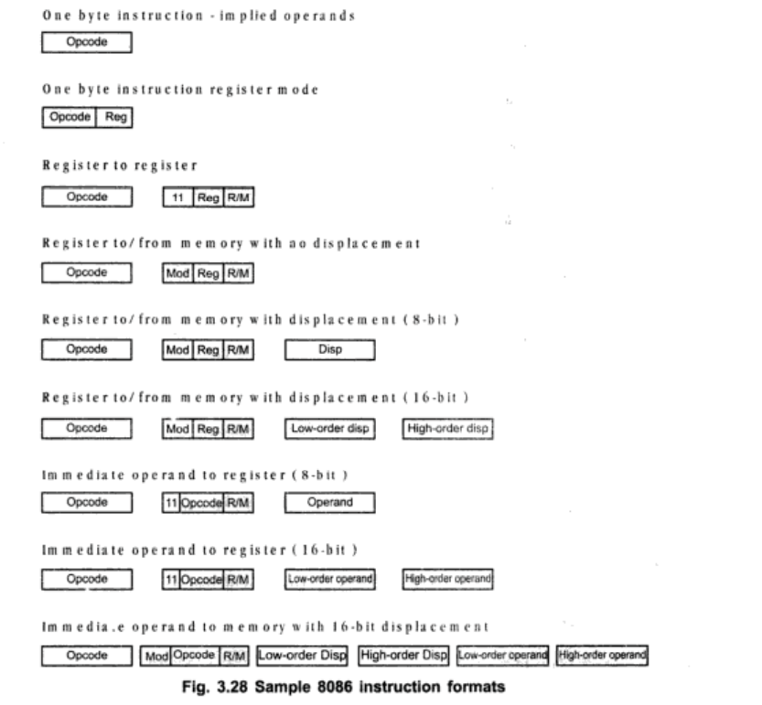

Slide 32
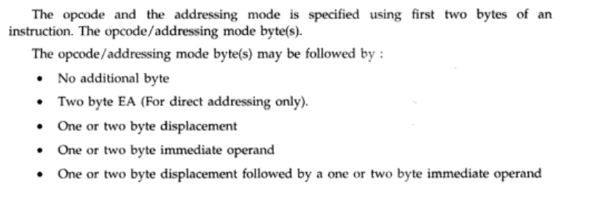

Slide 33
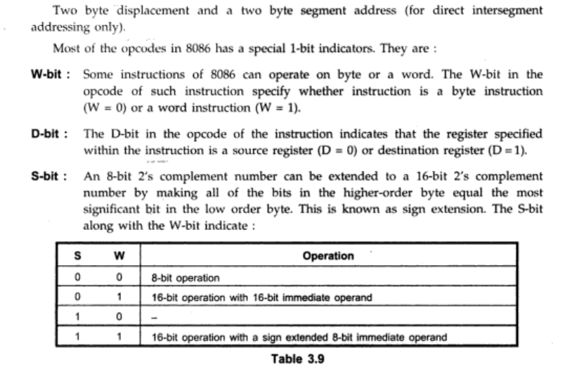

Slide 34
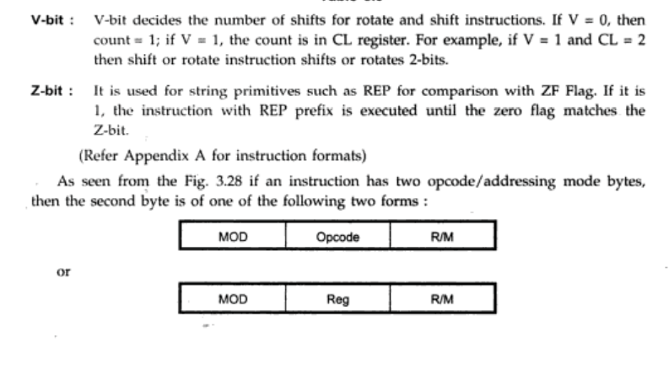

Slide 35
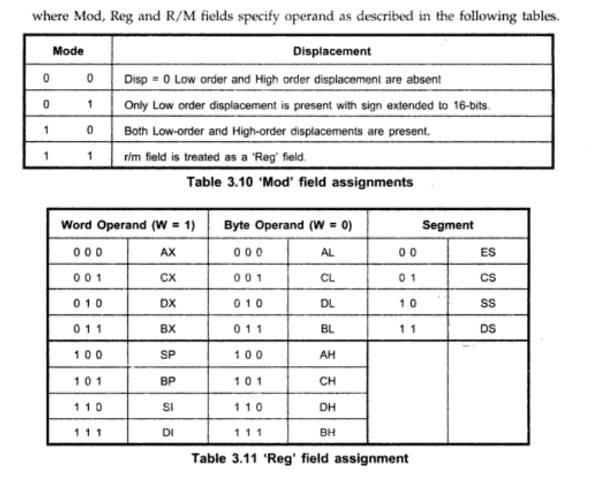

Slide 36
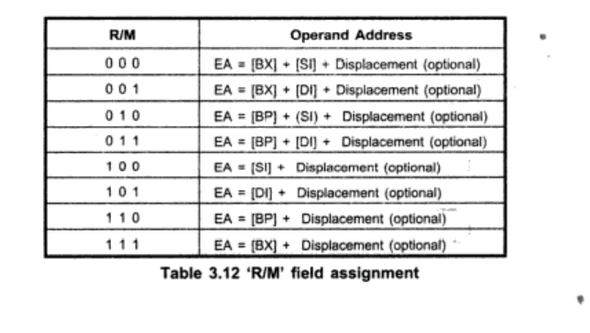

Slide 37
Interrupts
Interrupt Types
Hardware Interrupts: External event
Software Interrupts: Internal event (Software generated)
Maskable and non-maskable interrupts
Interrupt priority

Slide 38
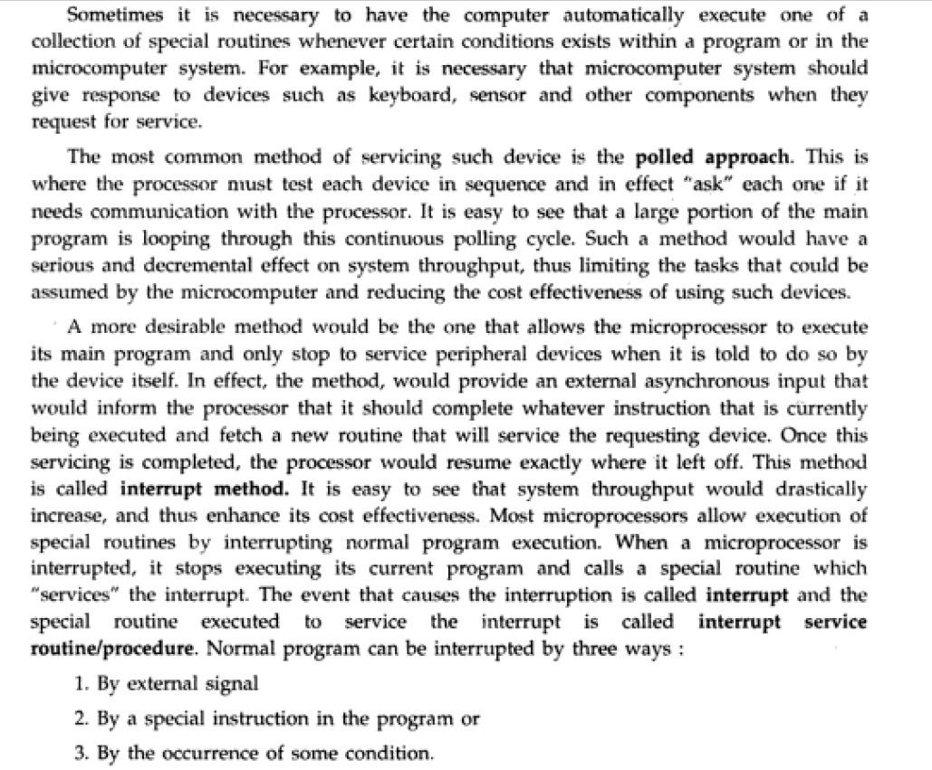

Slide 39
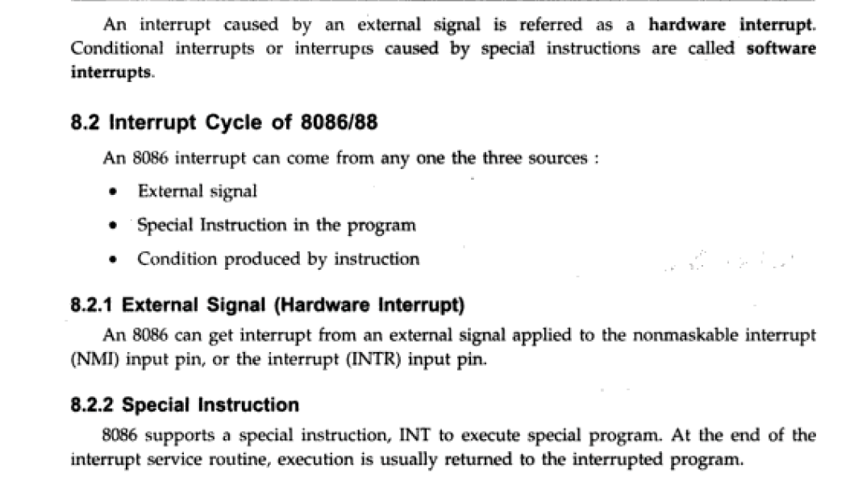

Slide 40
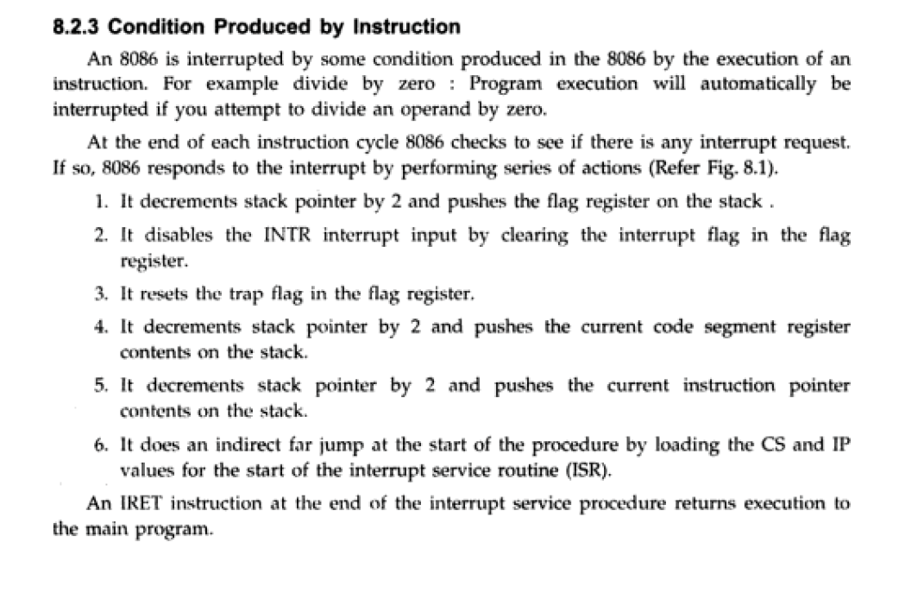

Slide 41
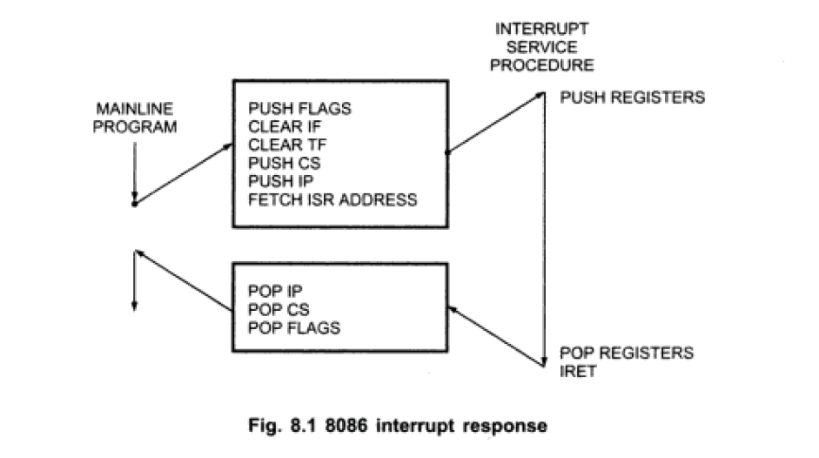

Slide 42
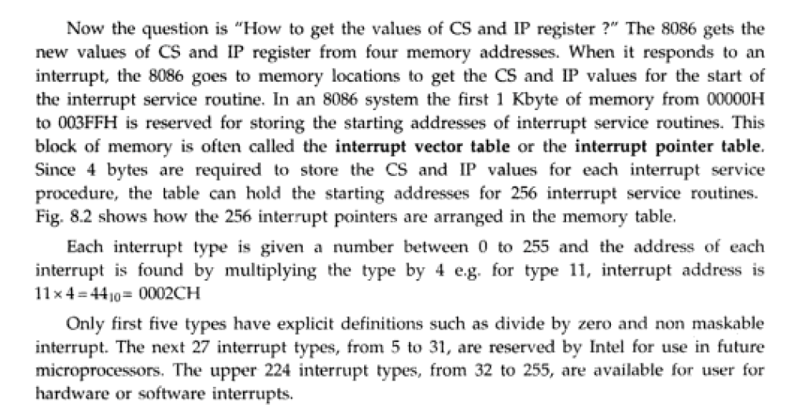

Slide 43
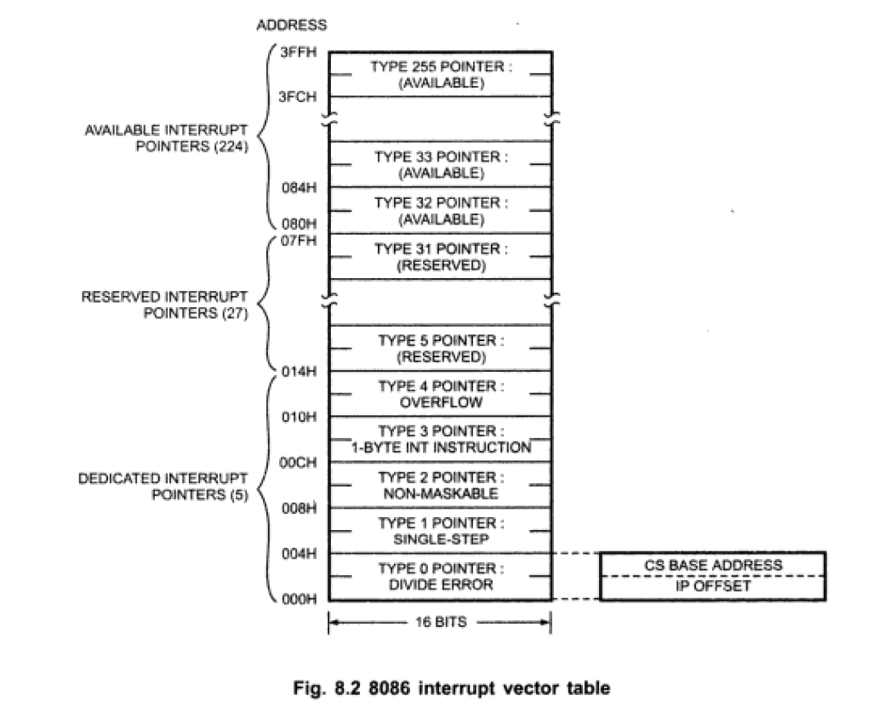

Slide 44
8086 INTERRUPT TYPES
256 INTERRUPTS OF 8086 ARE DIVIDED IN TO 3 GROUPS
TYPE 0 TO TYPE 4 INTERRUPTS-
THESE ARE USED FOR FIXED OPERATIONS AND
HENCE ARE CALLED DEDICATED INTERRUPTS
TYPE 5 TO TYPE 31 INTERRUPTS
NOT USED BY 8086,RESERVED FOR HIGHER PROCESSORS LIKE 80286 80386 ETC
TYPE 32 TO 255 INTERRUPTS
AVAILABLE FOR USER,CALLED USER DEFINED INTERRUPTS
THESE CAN BE H/W INTERRUPTS AND ACTIVATED THROUGH INTR LINE
OR CAN BE S/W INTERRUPTS

Slide 45
TYPE – 0 DIVIDE ERROR INTERRUPT
QUOTIENT IS LARGE CANT BE FIT IN AL/AX OR DIVIDE BY ZERO
TYPE –1 SINGLE STEP INTERRUPT
USED FOR EXECUTING THE PROGRAM IN SINGLE STEP MODE BY
SETTING TRAP FLAG
TO SET TRAP FLAG PUSHF
MOV BP,SP
OR [BP+0],0100H;SET BIT8
POPF
TYPE – 2 NON MASKABLE INTERRUPT
THIS INTERRUPT IS USED FOR EXECUTING ISR OF NMI PIN
(POSITIVE EGDE SIGNAL). NMI CANT BE MASKED BY S/W
TYPE – 3 BREAK POINT INTERRUPT
USED FOR PROVIDING BREAK POINTS IN THE PROGRAM
TYPE – 4 OVER FLOW INTERRUPT
USED TO HANDLE ANY OVERFLOW ERROR AFTER SIGNED ARITHMETIC

Slide 46
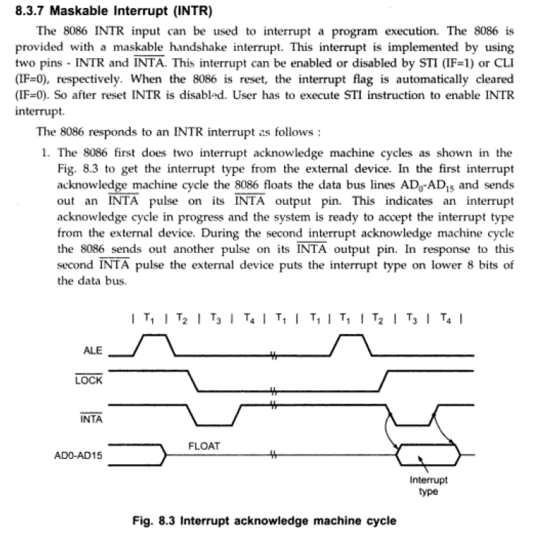

Slide 47
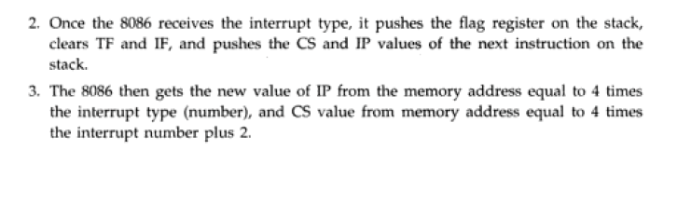

Slide 48
